Slide 1
Home Mod Metrics by the Home Modification Occupational Therapy Alliance
Creating homes for all abilities.

Slide 2
HMOTA is an alliance of 1500 occupational therapists throughout the United States that specialize in home modifications.
HMOTA’s home mod evaluation and expert trained home mod OT’s can help you to make your constituents safer in their homes using research-based evaluations, techniques and adaptive equipment to provide low-cost, high-impact home modifications to allow you to reach as many consumers as possible.

Slide 3
Home Mod Metrics
Mission Statement
Implementation of research-based interventions by home modification occupational therapists to decrease risk of falls, caregiver costs and facility placement for community residing older adults and people with disabilities.

Slide 4
About Us
The Home Modification Occupational Therapy Alliance, HMOTA, is a for-profit company with over 1500 occupational therapists that specialize in home modifications. HMOTA ensures that each home mod OT that is assigned to a contract receives mentoring and utilizes HMOTA evaluations and procedures to ensure high-quality, consistency, and expertise.
The Home Mod Metrics program is a program that was developed based on the CAPABLE program and Safer at Home research. Home Mod Metrics is a research-based fall prevention home modification program that specializes in low-cost, high-impact home modifications to prevent falls and increase independence.

Slide 5
Home Mod Metrics for Tribal Elders
Program is designed for Tribal Elders over the age of 60 years old, to take care of the Elders and help them to age in place in their homes.

Slide 6
Home Mod Metrics for Tribal Elders
Includes:
Occupational therapy home evaluation to identify mobility and medical issues of Elder.
Scope of work developed by the occupational therapist with construction specifications for builder.
Elder receives $10,000 of home modifications annually for maintenance and to increase safety in the home.
Occupational therapist returns to the home to work with Elder on safe use of modifications.
Project management available if needed.

Slide 7
Falls are a serious issue for seniors
1 out of 3 seniors who lives independently will experience a major fall each year.
25% of seniors who suffer hip fractures dies within one year

Slide 8
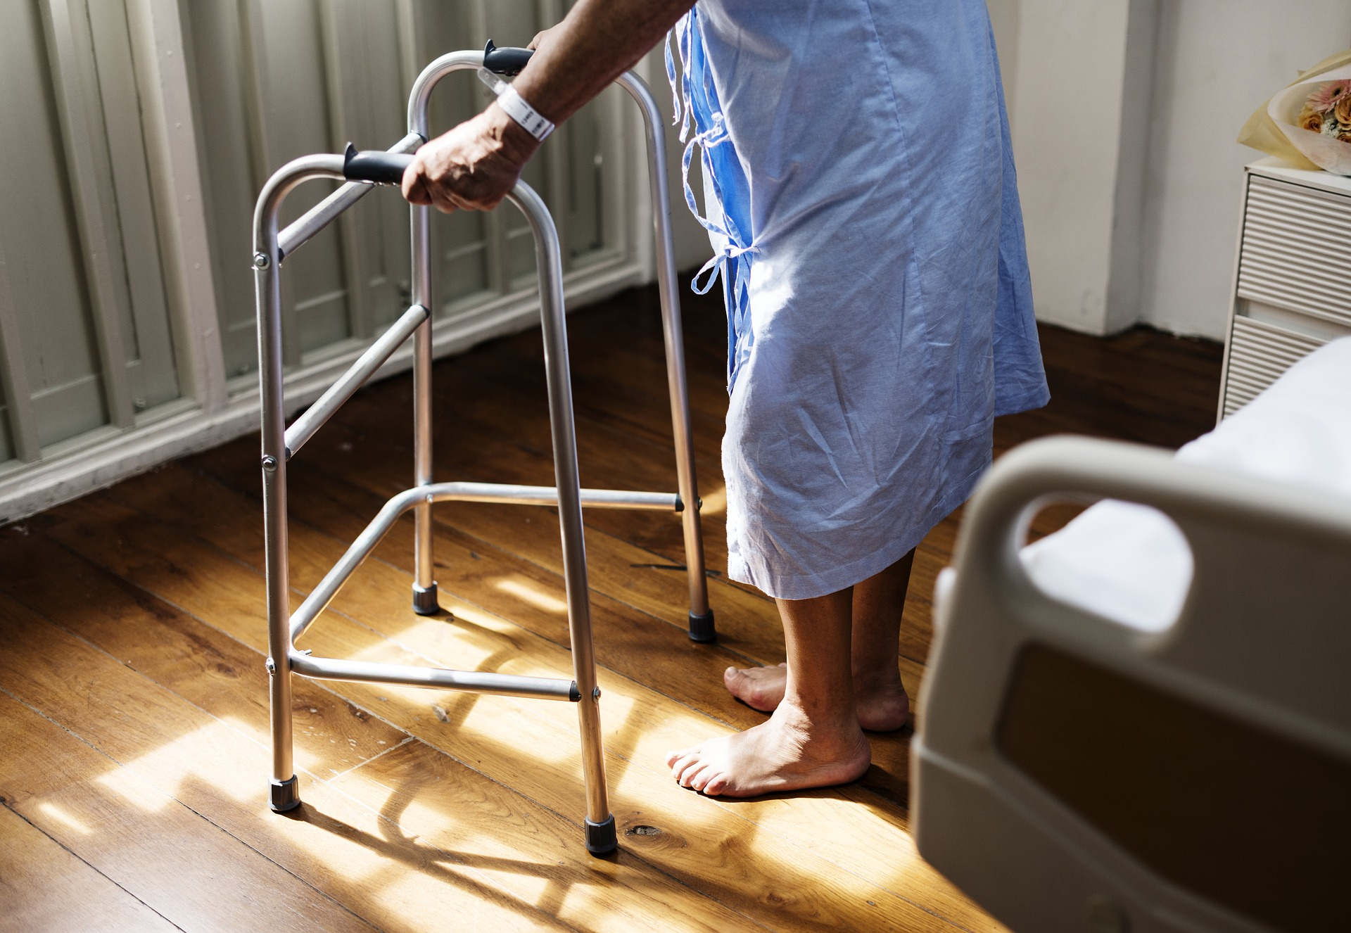
Falls are not okay
20%-30% of falls result in moderate to severe injury reducing the ability to live independently and increasing the risk of early death.
People age 75 and older who fall are 4-5 times more likely than those age 65-74 to be admitted to a long-term care facility for a year or longer.

Slide 9
Fall Risks
Per the CDC
Balance and Strength
Medications
Vision
Environment (*home modifications)

Slide 10
Home Mod Metrics Procedures
Eligibility to be determined in partnership with funder but should include
Community based adult over age 60 or 18-59 with disability
Fall risk concerns
Referral to Home Mod Metrics office
Initial visit by Occupational Therapist
Administerstandardized assessments
Create scope of work
HMOTA to provide Elder with design options.
Final visit by Occupational Therapist
Re-administer 2 assessments for outcomes
Training

Slide 11
Home Mod Metrics
Evidence based program to reduce falls implemented by Occupational Therapists (OT) utilizing low-cost home modifications and adaptive equipment.
Pre-selected items
Visit by OT before and after mod installations
Outcome data collected

Slide 12
Research and Evidence
Several studies have concluded that simple home modifications as recommended by an Occupational Therapist (OT) result in decreased falls. [i][ii]
[i] Pighills AC, Torgerson DJ, Sheldon TA, Drummond AE, Bland JM. Environmental assessment and modification to prevent falls in older people. Journal of the American Geriatrics Society. 2011;59(1):26–33
[ii] Cumming RG, Thomas M, Szonyi M, Salkeld G, O’Neill E, Westburg C, Frampton G. Home visits by an occupational therapist for assessment and modification of environmental hazards: A randomized trial of falls prevention. Journal of the American Geriatrics Society. 1999 Dec;47(12):1397–1402

Slide 13
Research and Evidence
The VIP Trial[iii] concluded that a home safety program led by an OT resulted in a 66% decrease in falls. The study went on to conclude that “the OT’s advice rather than the environmental changes was key” and that “a trained and experienced OT is critical to the success of this intervention.
[iii] La Grow SJ, Robertson MC, Campbell AJ, Clarke GA, Kerse NM. Reducing hazard related falls in people 75 years and older with significant visual impairment: How did a successful program work? Injury Prevention. 2006 Oct;12(5):296–301

Slide 14
Pilot Program Washington DC
Outcomes
Served over 3500 clients
Has reduced reported fall rates by over 80%
Reduced fear of falling and home safety hazards by over 50%
Average scope of work cost = $3900

Slide 15
Case Study 1
89-year old woman, in nursing home following stroke.
mild confusion
residual weakness, walks with walker
had Covid in facility but recovered without residual effects
5’6” and 286 pounds
high fall risk due to confusion and leg weakness
Granddaughter wants to move her to her home
no stairs to enter house
first floor bedroom and full bathroom
Concerns
Toilet and shower transfers

Slide 16
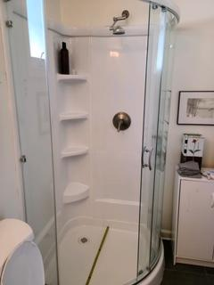
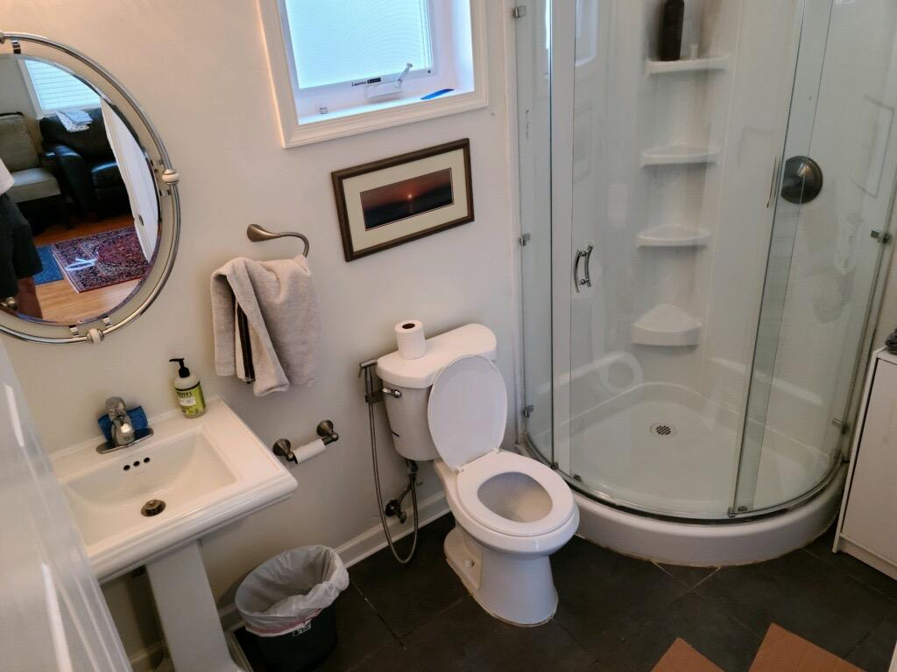
Case Study 1 Before

Slide 17
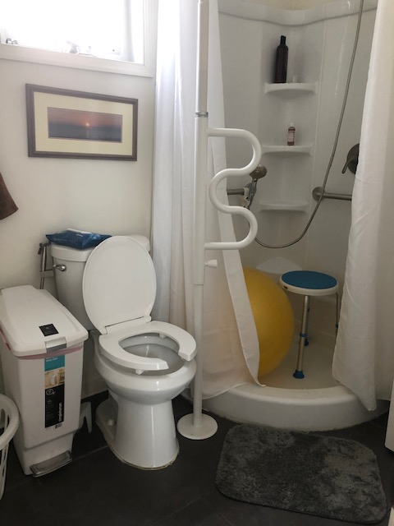
Case Study 1 After
Remove shower doors; store doors for client
Install flexible shower curtain rod and long curtain
Super pole with pivot arm between toilet and shower *position for use from toilet and from shower
18" horizontal grab bars on each wall in shower x 2
Handheld shower
Clamp on grab bar for handheld
2" toilet seat riser
$1455 including OT and home mods.

Slide 18
Case Study 2
73 year-old man, recently moved into his daughter’s home
abscess in spine affects walking, can’t do surgery due to underlying health conditions including kidney failure and cardiac disease
high risk of falls due to poor balance, decreased leg strength and history of falls
uses walker, walks with supervision due to fall risk
staying on first floor due to inability to go upstairs
Concerns
going upstairs for bedroom and bathroom
safe showering

Slide 19
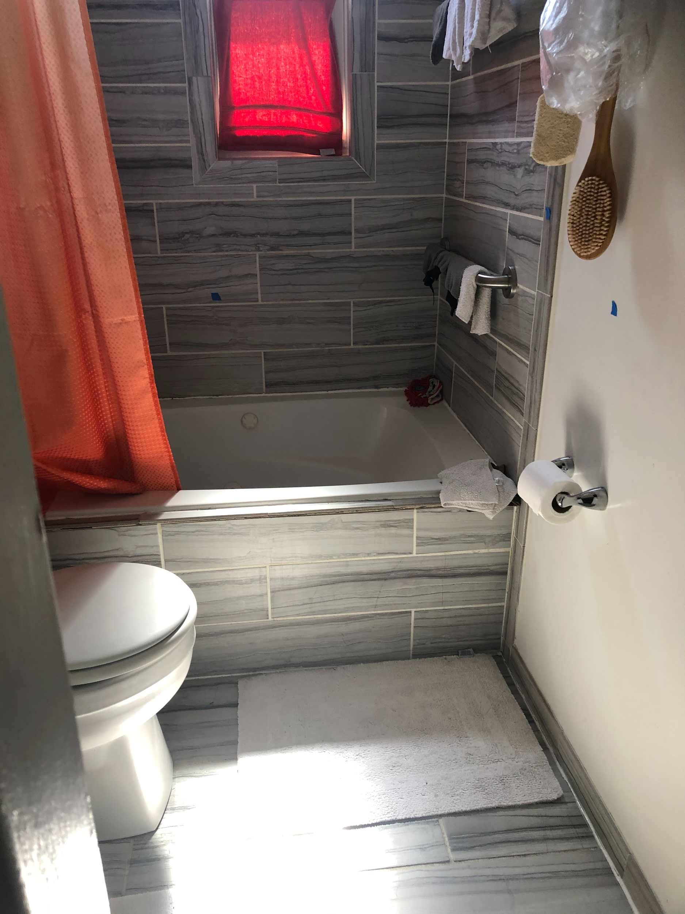
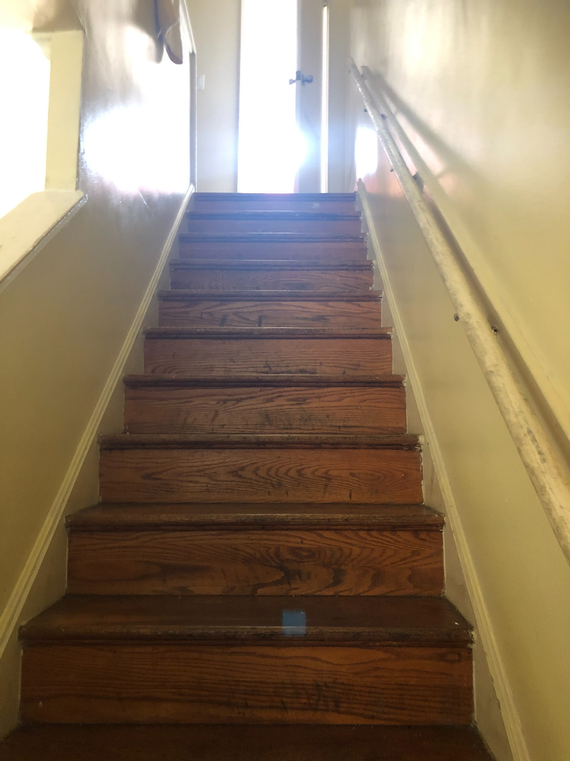
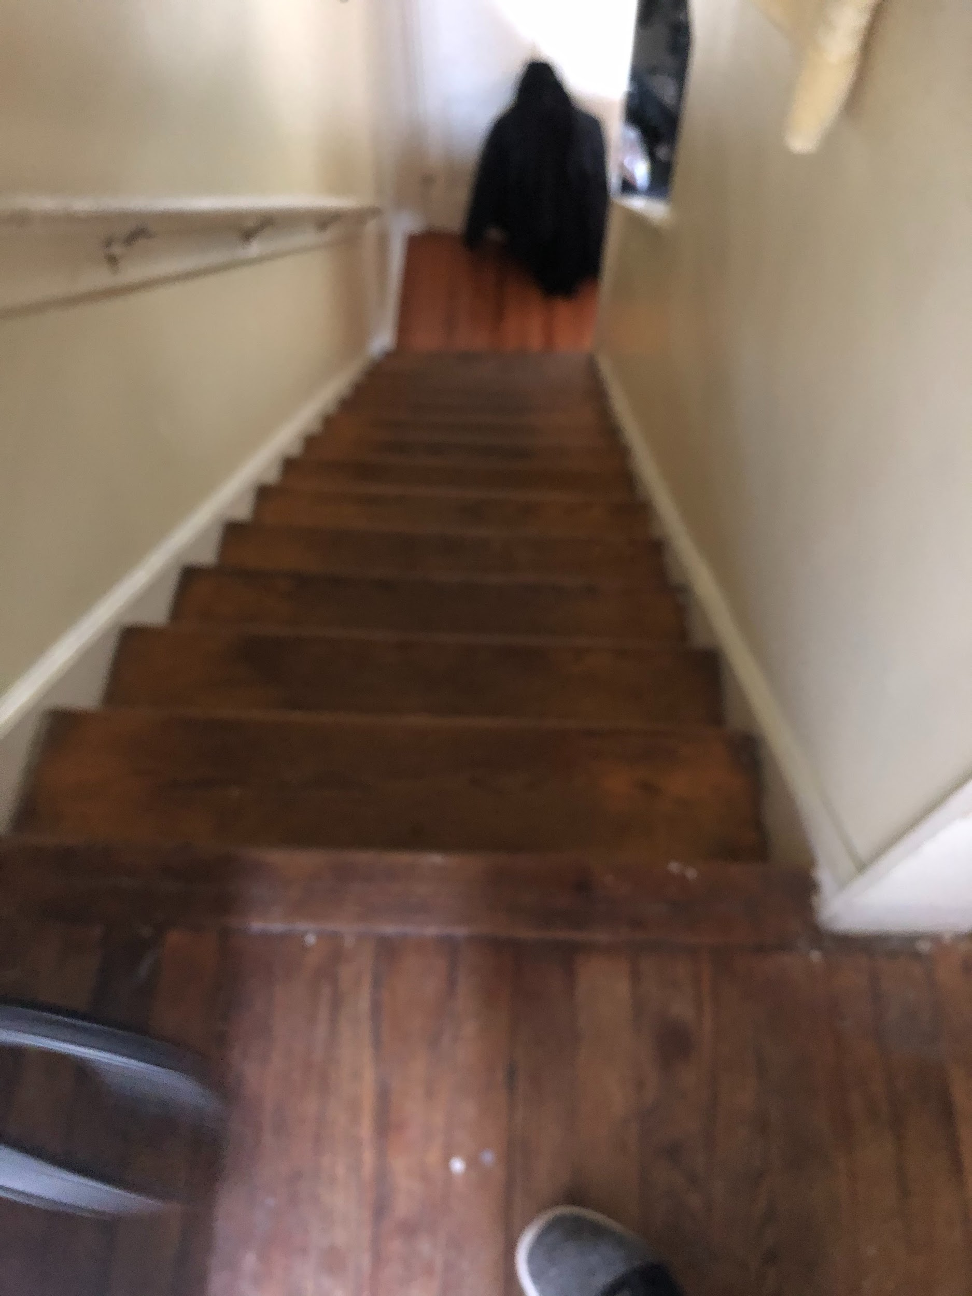
Case Study 2 Before

Slide 20
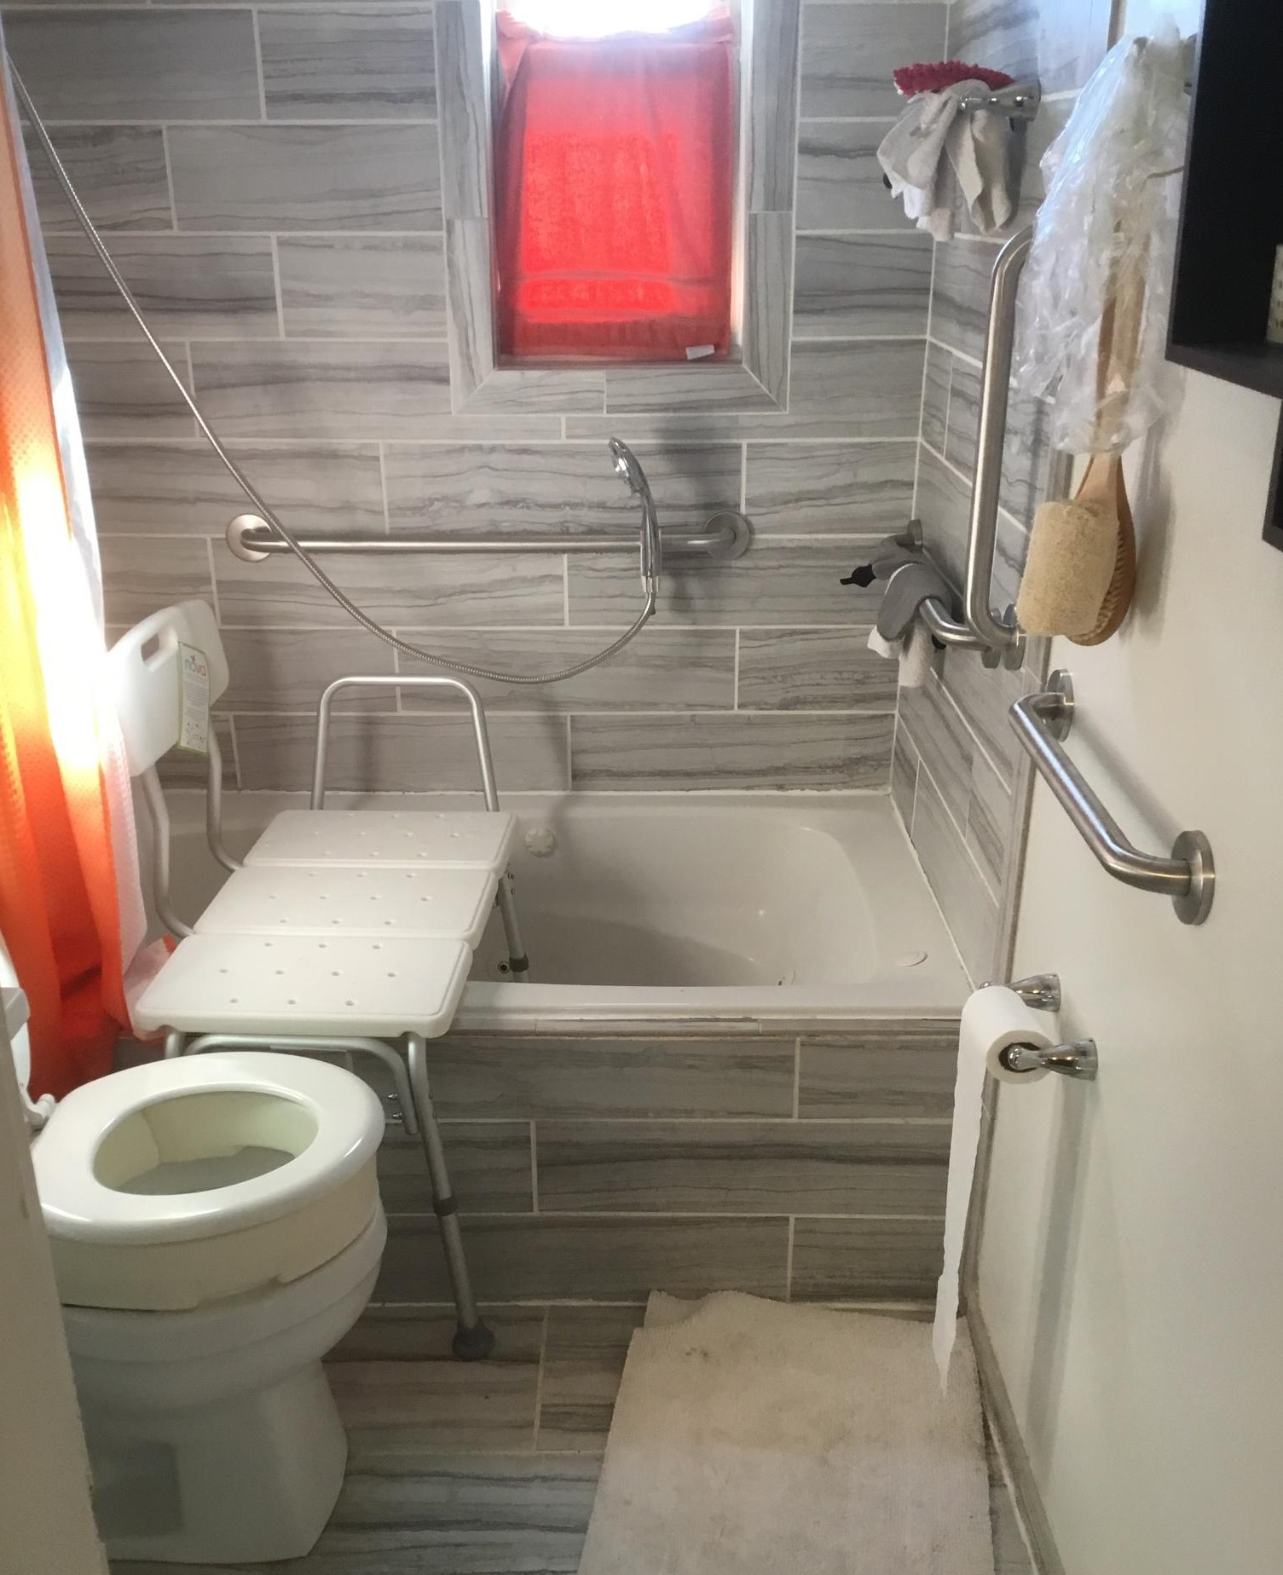
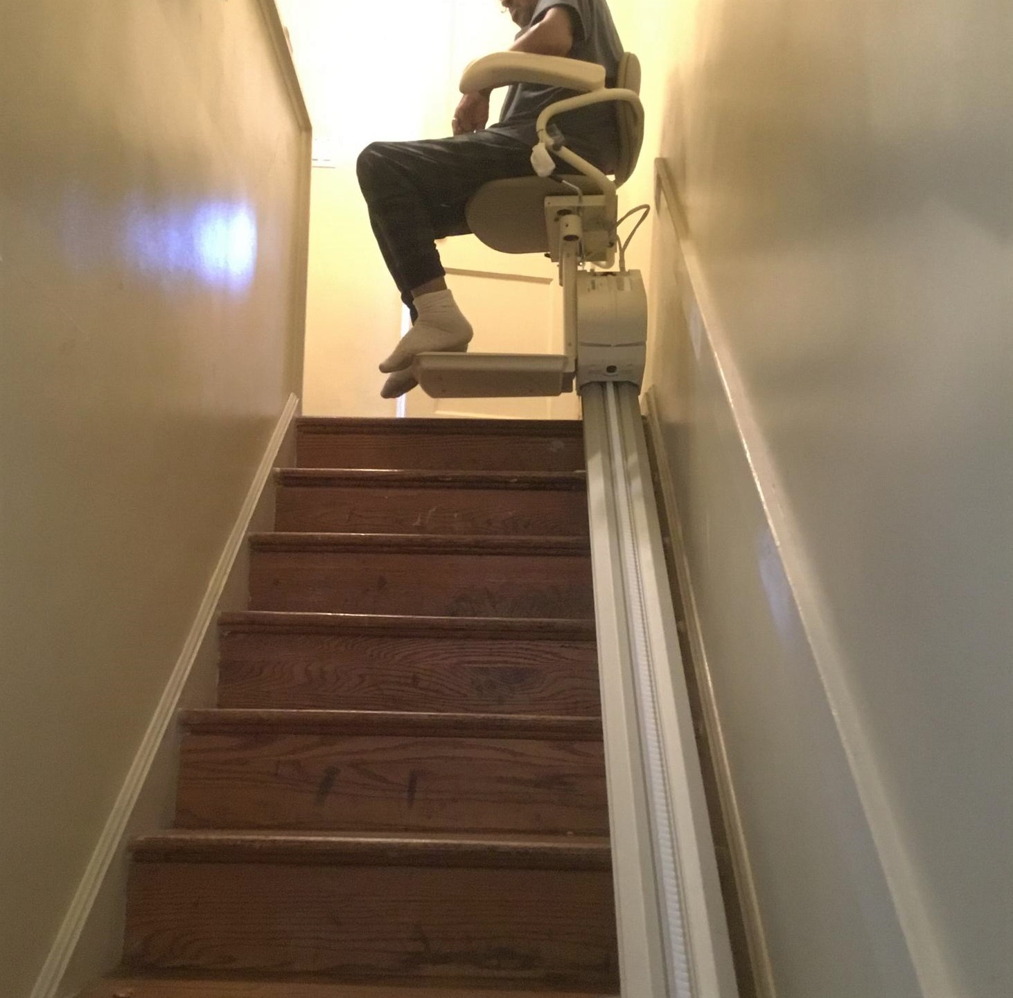
Case Study 2 After

Slide 21
Case Study 2 Scope
Tub transfer bench next to toilet, REVERSE set up
Stairlift x 168" x 36" W
3.5" toilet rer
18" vertical grab bar wall opposite diverter
32" horizontal grab bar side wall
18" horizontal grab bar across from toilet
Handheld shower
Clamp on grab bar for handheld
$4355 including OT and home mods.

Slide 22
Case Study 3
93-year-old woman, moderate dementia
walks without assistive device
cared for by family
no recent falls
Concerns
safe showering

Slide 23
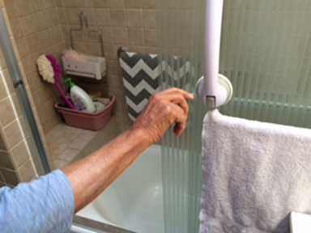
Case Study 3 Before

Slide 24
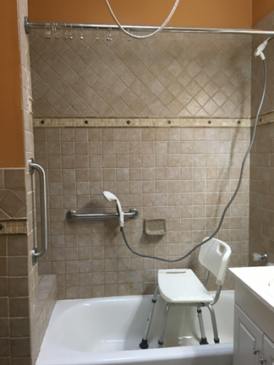
Case Study 3 After
18” vertical grab bar
18” horizontal grab bar
Remove shower doors; add curtain rod and roller rings
Handheld shower
Clamp for handheld
Shower seat *reverse set up
$975 including OT and home mods.

Slide 25
Working with HMOTA
We are striving to make Home Mod Metrics a very flexible program that can support non-profits who have or would like to have home modification programs.
We will work with your Tribe to tailor our approach to your culture and your Elder’s needs.
HMOTA is a national company, we are able to provide services to your local Elders and Elders who live in other areas throughout the US.

Slide 26
Working with HMOTA
HMOTA can provide the following:
Home mod OT’s with standardized assessments.
Adaptive equipment.
Training of staff.
We can tailor our program to fit your needs.

Slide 27
Contact us:
www.hmota.net
Karen Koch: info@hmota.net

Slide 28
Resources
National
Habitat for Humanity
Rebuilding Together
CDC STEADI tool - fall risk management information and protocols
National Council on Aging - NCOA fall prevention information

