Slide 1
Southwest Office of Native American Programs
SWTHA TriAnnual Meeting
Sept. 18, 2024
Hondah Resort, Pinetop, AZ

Slide 2
Southwest Office of Native American Programs
Dr. Corinna Stiles, Administrator
Floyd Tortalita, Deputy Administrator
Phoenix Office Albuquerque Office
2800 North Central Ave-Suite 700 500 Gold Ave, SW, 7th Floor, Ste 7301
Phoenix, AZ 85004 P.O. Box 906
(602) 379-7100 Albuquerque, NM 87103-0906
(505) 346-6923

Slide 3
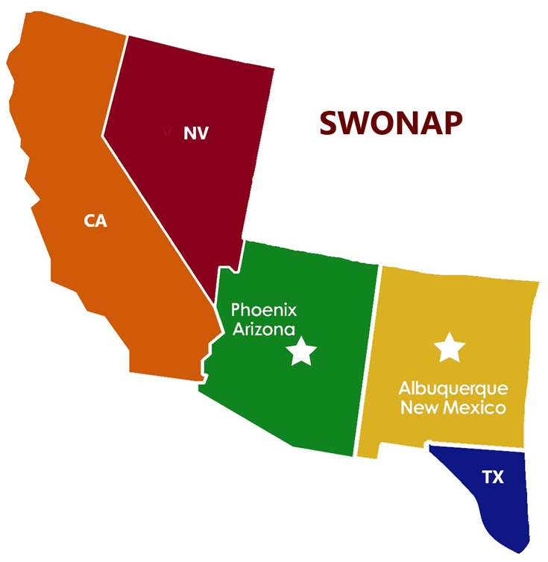
Who We Are: Office of Native American Programs
Alaska Region (Alaska)
Northwest Region (Idaho, Oregon, and Washington)
Northern Plains Region (Colorado, Montana, North Dakota, Nebraska, South Dakota, Utah, and Wyoming)
Southern Plains Region (Kansas, Louisiana, Missouri, Oklahoma, and Texas)
Eastern/Woodlands Region (Alabama, Connecticut, Florida, Iowa, Massachusetts, Maine, Michigan, Minnesota, Mississippi, North Carolina, New York, Rhode Island, South Carolina, Virginia, and Wisconsin)
Southwest Region (Arizona, California, New Mexico, Nevada, West TX)

Slide 4
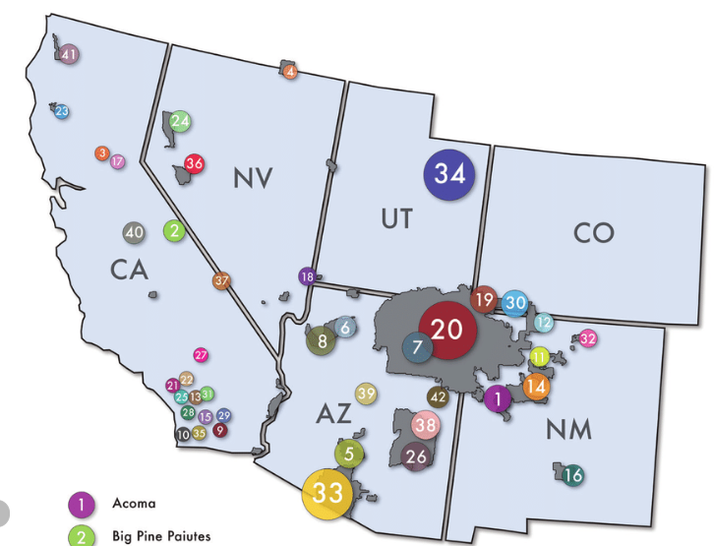
174 Indian Nations in SWONAP area 157 grantees (Tribes & TDHEs)
Who We Serve: SWONAP’s Service Region
California – 109 Tribes/Rancherias/
Colonies
Arizona – 22 Tribes
New Mexico
Nevada – 19 Tribes
New Mexico – 23 Pueblos/Tribes

Slide 5
What We Do: Office of Native American Programs (ONAP)
ONAP's Mission
To increase the supply of safe, decent, and affordable housing available to Native American families.
To strengthen communities by improving living conditions and creating economic opportunities for tribes and Indian housing residents; and
To ensure fiscal integrity in the operation of the programs it administers.

Slide 6
SWONAP Team
ADMINISTRATOR
Administrator Advisor
Native American Program Specialist
Deputy Administrator
Grants Evaluation Director (2)
Grants Management Director (2)
Team Leads (4)
Team Leads (4)
(36 staff in Phoenix and Albuquerque)
GE Specialists (8)
GM Specialists (11)

Slide 7
SWONAP Funding Programs
Indian Housing Block Grant Program
Indian Housing Block Grant Competitive Program
Indian Community Development Block Grant
Indian Home Loan Guarantee Program (Section 184)
Title VI Loan Guarantee Program
Tribal HUD-VASH Program
Other
CARES ACT
American Rescue Plan
ROSS

Slide 8
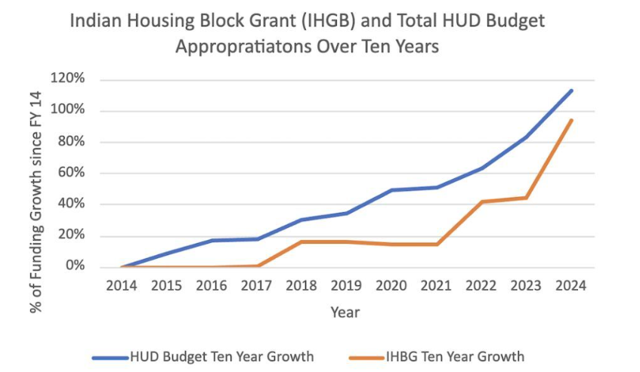
IHBG Appropriations Growth 2014-2024
The ‘minibus’ appropriations package, the Consolidated Appropriations Act of 2024, provided $1.34 billion for Native American Programs, a $324 million increase (32%) above the FY23 enacted. This includes $1.11 billion for the Indian Housing Block Grant (IHBG), formula, a $324 million (41%) increase above FY23 enacted.

Slide 9
The Consolidated Appropriations Act of 2024 for Native American Programs
$1.1 billion for formula Indian Housing Block Grants (IHBG) $324 million (41%) more than the 2023 Appropriations Act. $150 million for IHBG competitive grants; $ 75 million for Indian Community Development Block Grants; $ 1 million for Title VI; $ 22.3 million for Native Hawaiian Housing Block Grants; and
$ 7 million for Technical Assistance and Training, includes a $2 million set-aside for NAHASDA technical assistance.
$1.34 Billion

Slide 10
Training and Technical Assistance
ONAP TRAINING
Group Trainings open to all Tribes and TDHEs in a region or all Indian country.
SWONAP TRAINING
Trainings provided by SWONAP staff to all Tribes and TDHEs in SWONAP region.
TECHNICAL ASSISTANCE
Tailored one-on-one assistance, support, and training for a particular Tribe or TDHE to address a specific need or programmatic issue.

Slide 11
Training and Technical Assistance – Sample Topics
Addressing Housing and Community Safety Needs
Tribal Housing Board Roles & Responsibilities
Contract Administration, Procurement
Financial Management & Reporting
Over Income and Essential Families
Managing Housing Programs
Admissions & Occupancy
NAHASDA Essentials
Program Income
Self-Monitoring
FREE!
FREE!
CONTACT: Debbie Broermann - deborah.s.broermann@hud.gov

Slide 12
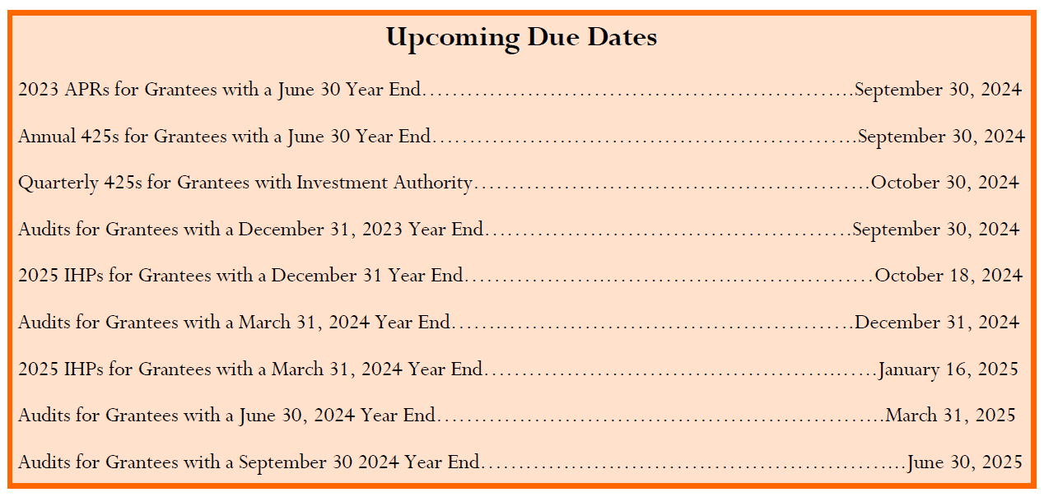
Annual Status and Evaluation Reports for ICDBG grants for Year End 9/30/2024 are due on November 14, 2024.

Slide 13
Helpful Resources …
ONAP Website - https://www.hud.gov/codetalk SWONAP Website - https://www.hud.gov/program_offices/public_indian_housing/ih/codetalk/onap/swonap SWONAP Grantee Assignments - https://www.hud.gov/sites/dfiles/PIH/documents/SWONAP_Grantee_Assignments.pdf ONAP Calendar of Events (Free Trainings) Website - https://www.hud.gov/program_offices/public_indian_housing/ih/codetalk/calendar
Corinna H. Stiles, Administrator Corinna.h.stiles@hud.gov
Floyd Tortalita, Deputy Administrator Floyd.D.Tortalita@hud.gov

Slide 14
SWONAP Initiatives
Expand Funding and Training Opportunities for SWONAP Grantees
Promote Tribal Programs and Resources
Foster Tribal Partnerships and Collaborations

Slide 15
Southwest Office of Native American Programs
Thank You!!
Floyd Tortalita,
Deputy Administrator
(505) 346-6924
Floyd.D.Tortalita@hud.gov
Dr. Corinna Stiles, Administrator (602) 379-7235
Corinna.H.Stiles@hud.gov
Notes:
Q&A:
Over income and essential families

