Slide 2
AGENDA
Staff Introduction
Education landscape and market needs
General Construction Overview
Alumni stories
Cost and Commitment
Next Steps
Questions

Slide 3
StAFF
CLAYTON ABERNATHY
Founder
NELSON
BROWN
Vice President of Education
TERESA
SANCHEZ
Enrollment Specialist

Slide 4
For 30 years society has been telling the story that:
Everyone should go to college.
You won't be admired without a college degree.
If you can’t sit in class and learn by listening, you won't be successful.
Only uneducated people are in construction.
If you can't pass standardized testing, you won't have success in life.

Slide 5
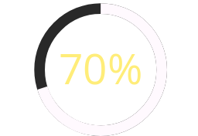
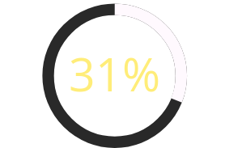
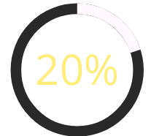
POST-SECONDARY EDUCATION STATISTICS
High school students going directly into college.
U.S. Average College Graduation rate.
Needed a degree for the work they are currently in.

Slide 6
Education Landscape
1
A DEGREE IS NOT WHAT IT USED TO BE
Rapid technological change, combined with rising education costs, have made our traditional higher-education system an increasingly anachronistic and risky path.
2
LACK OF SKILLED CRAFTSMEN IS REACHING A CRISIS LEVEL AND RISING
By 2030 the U.S. will be lacking millions construction workers.
From now until 2030, 10,000 Baby Boomers will hit retirement age each day.
Craftsmen's skills did not get passed to the upcoming generation.
3
Tuition Cost On the Rise
The average college student is in debt until their mid 40's
Education debt does not equate to higher paying jobs.

Slide 7
Market Landscape
The construction industry is huge, “stable”, as old as the world, and consumes up to 10% of all money used in the world.
The construction industry is lacking 1,000,000 workers today and 2,000,000 in three years.
Construction spending 2.1 billion July 2024
Government signed 1 Trillion infastrcuture

Slide 8
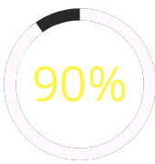
Idea'l Landscape
Electricians provide light when everything is dark!!!
Graduation Rate
Carpenters keep your structures standing!!!
Job Placement after graduation
Plumbers have saved
more lives than doctors!!
Students with zero tuition debt

Slide 9
WHAT WE DO
Students
IDEA'L CREATES CONSTRUCTION CRAFTSMEN, THROUGH BUILDING AFFORDABLE HOUSING
Hands-on perceptual learning
Provides general construction course building modular homes.
Build aspect of homes within 6 month
Debt-free upon graduation
Graduate with tools.
Licensed contractor in
State of Arizona.

Slide 10
Foundation Construction Program Overview
OSHA 10 Hour Certification
R62 AZ ROC Exam Preparation
Core Construction Skills
Students will achieve certification ensuring they are knowledgeable about workplace safety guidelines, enhancing their employability and safeguarding their health.
Our program includes comprehensive preparatory coursework ensuring students are well-equipped to succeed on Arizona's R62 contractor license exam.
Students gain hands-on experience and technical skills in critical areas such as plumbing, electrical, and HVAC systems, essential for modern construction.

Slide 11
Program Schedule and Accessibility
Learning Structures to Commit to Your Future
Daily Hours: Our program operates Monday through Friday for 8-hour sessions. 6:30a-2:30p
Next Start Dates:
No Educational Prerequisites: We welcome students without requiring a high school diploma or GED

Slide 12
Our Graduates
Alumni Success: Numerous alumni have progressed into rewarding careers within the construction industry
Community Feedback: Positive feedback from employers highlights the quality and preparedness of our graduates in meeting industry standards.
Impact Stories: Alumni frequently share their transformational journeys, inspiring current students with narratives of personal growth and career advancement.

Slide 14
Cost and commitment
Tuition Cost: The student is only required to pay $2000 out of pocket. This fee includes a $500 registration fee and $1500 tuition deposit.
The tuition is $14,000 and the additional $12,500 is only paid if the student does not complete the program in full.
However, if a student satisfactorily completes the full hours needed to complete the program, then the $12,500 will be waived, and the student will no longer be responsible for paying tuition.
Commitment: 6 months, 8 hour Days
Next Steps

Slide 15
THANK YOU

